Slide 1
Reinforcement Learning
Shen Bingquan <sbingqua@dso.org.sg>
National University of Singapore :: School of Engineering :: Engineering Science Programme

Slide 2
Contents
Learning Outcome: Given an application problem how (and whether) to use RL for it.
The reinforcement learning problem
Markov Decision Processes
Components of a RL Agent
Dynamic Programming
Policy Iteration
Value Iteration
Temporal Difference Learning
Sarsa
Q-learning
Exploration and Exploitation
Deep Reinforcement Learning Example - DQN
Challenges

Slide 3
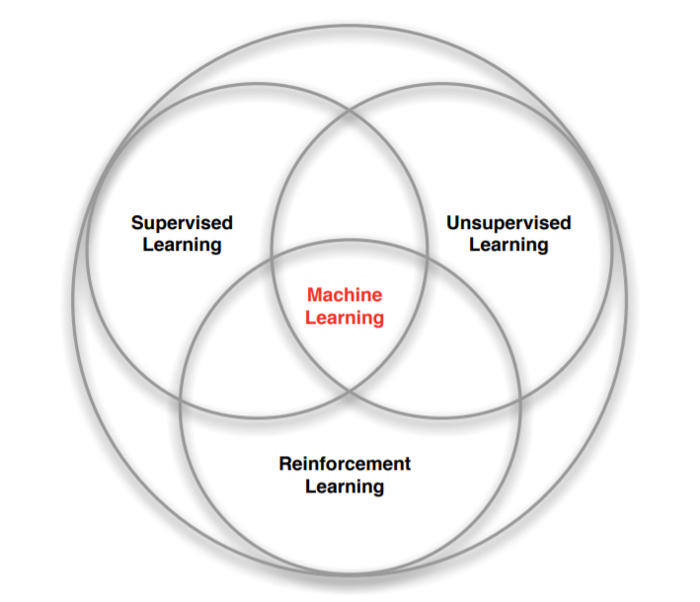
Branches of Machine Learning
https://deepmind.com/learning-resources/-introduction-reinforcement-learning-david-silver

Slide 4
Characteristics of Reinforcement Learning
What makes reinforcement learning different from other machine learning paradigms?
There is no supervisor, only a reward signal
Feedback is delayed, not instantaneous
Time really matters (sequential, non i.i.d data)
Agent’s actions affect the subsequent data it receives
https://deepmind.com/learning-resources/-introduction-reinforcement-learning-david-silver

Slide 5

The Reinforcement Learning Problem
Objective of Agent
Learn to make good sequences of decisions.
By Selecting actions so as to maximize total future rewards (accumulated reward).
Grid World Example
state
reward
action
1,3 | 2,3 | 3,3 | 4,1
1,2 |  | 3,2 | 4,2
1,1 | 2,1 | 3,1 | 4,1
0 | 0 | 0 | +1
0 |  | 0 | -1
0 | 0 | 0 | 0
 | 0,1
-1,0 |  | 1,0
 | 0,-1

Slide 6
State
Fully observable state
1,3 | 2,3 | 3,3 | 4,1
1,2 |  | 3,2 | 4,2
1,1 | 2,1 | 3,1 | 4,1
Environment State The actual state used for generating next observation and reward.
Observed State The agents perceived state.
----------------------------------------------------------
Full observability
Observed State = Environment State
Partial observability
Observed State ≠ Environment State
 | 0
0 | A | 1
 | 1
Partially observable state
 |  |  | +1
 |  |  | -1
 | 0
1 | B | 1
 | 0

Slide 7
Reward
Agent’s Goal
To maximize the total amount of reward. This means maximizing not immediate reward, but cumulative reward in the long run.
Formalizes the purpose of the agent.
A reward is a scalar feedback signal.
Indicates how well the agent is doing.
Examples
A robot learning to walk
Positive reward for forward speed
Negative reward for falling
Escaping a maze
Positive reward for successful escape
Negative reward at every time step while in the maze
reward
0 | 0 | 0 | +1
0 |  | 0 | -1
0 | 0 | 0 | 0
What is purpose of this agent?

Slide 8
Action
Decisions the agent can take while in the particular state.
state
t = 0
State: (1,1)
1,3 | 2,3 | 3,3 | 4,1
1,2 |  | 3,2 | 4,2
1,1 | 2,1 | 3,1 | 4,1
a: (0,1)
(1,0)
(0,-1)
(-1,0)
t = 1
State: (1,2)
(2,1)
(1,1)
(1,1)
Reward: (0)
(0)
(0)
(0)
action
t = 2
 | 0,1
-1,0 |  | 1,0
 | 0,-1
State: (2,1)
Rewards: …
(3,1)
(2,1)
(1,1)
t = L
Until Terminal States: (4,1) or (4,2)

Slide 9
Comparing RL to other AI
 | Search/ Planning | Supervised Learning | Unsupervised Learning | Reinforcement Learning | Imitation Learning
Optimization | ✔ |  |  | ✔ | ✔
Learning from experience |  | ✔ | ✔ | ✔ | ✔
Generalization | ✔ | ✔ | ✔ | ✔ | ✔
Delayed Consequences | ✔ |  |  | ✔ | ✔
Exploration |  |  |  | ✔
https://web.stanford.edu/class/cs234
Notes:
Planning assumes have a model of how decisions impact environment.
Supervised learning is provided correct labels
Unsupervised learning is provided no labels
Reinforcement learning is provided with censored labels
Imitation learning assumes input demonstrations of good policies. Imitation Learning reduces Reinforcement Learning to Supervised Learning.

Slide 10
Markov Decision Processes (MDPs)
Mathematical tool for sequential decision making which formally describes the environment for reinforcement learning.
MDP is a tuple <S, D, A, T, R>, where:
S is a finite state space
D is a sequence of discrete time steps/decision epochs (1,2,...L), L maybe ∞
A is a finite action set
T: S x A x S x D → [0,1] is a transition function
R: S x A x S X D → R is a reward function
Partially Observable MDPs (POMDPs) when states are partially observable
Solution: Optimal Policy, ℼ*
Notes:
Start by limiting both the actions and states to finite discrete values to avoid issues to do with dimensionality.
We will start by considering the most common simplifying case: the markov decision process (MDP). MDP's follow the markov property that the next state only depends on the current state and action. MDP are an extension of markov chains, with the addition of actions and rewards.

Slide 11
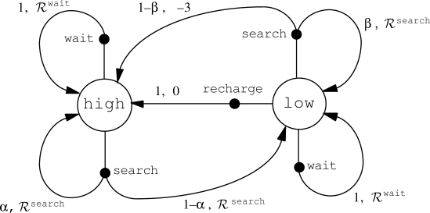
Example MDP
Transition graph of a recycling robot example

Slide 12
Components of an RL Agent
Policy, ℼ
Defines the behavior of an agent at a perceived state of the environment
Rewards Function, r(s,a)
Defines the goal in a reinforcement learning environment. It determines the immediate desirability of taking the particular action, a, while in observed state, s
Value function, V^{ℼ}(s,a)
Defines the expected total amount of reward an agent can accumulate over the future in that given state, s, while following the policy, ℼ.
Model of the environment (optional)
To predict the resultant next state and next reward. Models are used for planning.

Slide 13
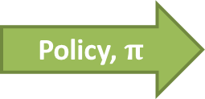
Policy, ℼ
Defines the behavior of an agent.
Action to take while in a particular state.
state
action to take
1,3 | 2,3 | 3,3 | 4,1
1,2 |  | 3,2 | 4,2
1,1 | 2,1 | 3,1 | 4,1
 |  |  | +1
 |  |  | -1

Slide 14
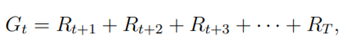
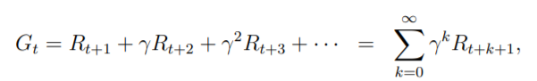
Value
What is the value function for of the previous policy?
Expected total amount of reward an agent can accumulate from this point onwards.
Sum of rewards:
where T is the final step
Discounted sum of rewards:
where 𝛾 is the discount rate range from [0,1]

Slide 15
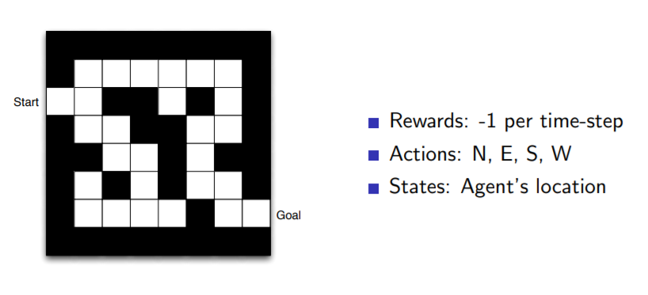
Maze Example
https://deepmind.com/learning-resources/-introduction-reinforcement-learning-david-silver

Slide 16
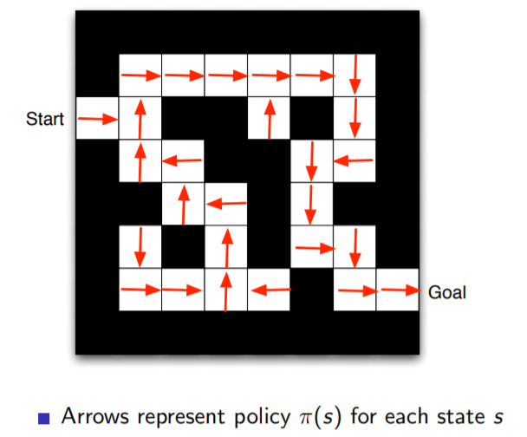
Policy
https://deepmind.com/learning-resources/-introduction-reinforcement-learning-david-silver

Slide 17
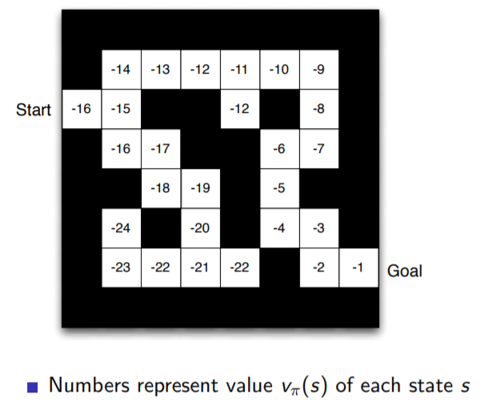
Value
https://deepmind.com/learning-resources/-introduction-reinforcement-learning-david-silver

Slide 18
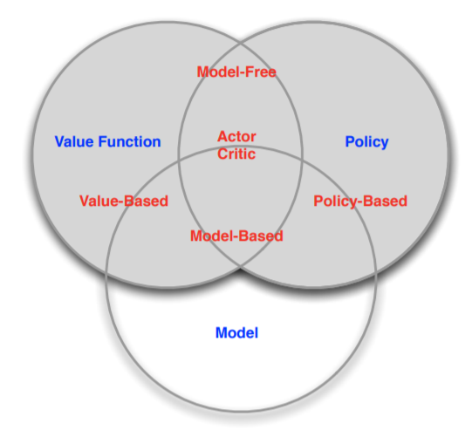
RL Agents
A model predicts what the environment will do next.
Next state
Next (immediate) reward
https://deepmind.com/learning-resources/-introduction-reinforcement-learning-david-silver

Slide 19
Dynamic Programming
Dynamic programming (DP) refers to a collection of algorithms that can be used to compute optimal policies given a perfect model of the environment as a MDP.
The key idea is the use of value functions to organize and structure the search for good policies.
It forms the foundation for other RL methods.
Steps
Break problems down into subproblems
Solve the subproblems
Combine solutions to subproblems
Sutton, R. S., & Barto, A. G. (2018). Reinforcement learning: An introduction. MIT press.
Notes:
Classical DP algorithms are of limited utility in reinforcement learning both because of their assumption of a perfect model and because of their great computational expense, but they are still important theoretically.

Slide 20
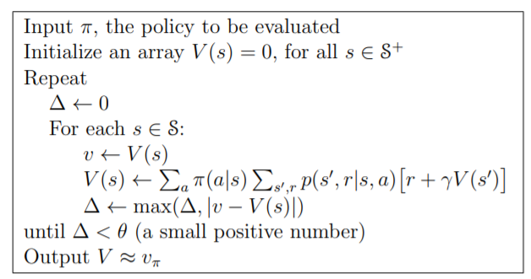
Iterative Policy Evaluation
First Step: To compute the state-value function v_{ℼ} for an arbitrary policy ℼ.
Probability of taking action a at state s under policy ℼ
Transition function and sum over all possible next states
← Bellman equation for v_{ℼ}
Sutton, R. S., & Barto, A. G. (2018). Reinforcement learning: An introduction. MIT press.

Slide 21
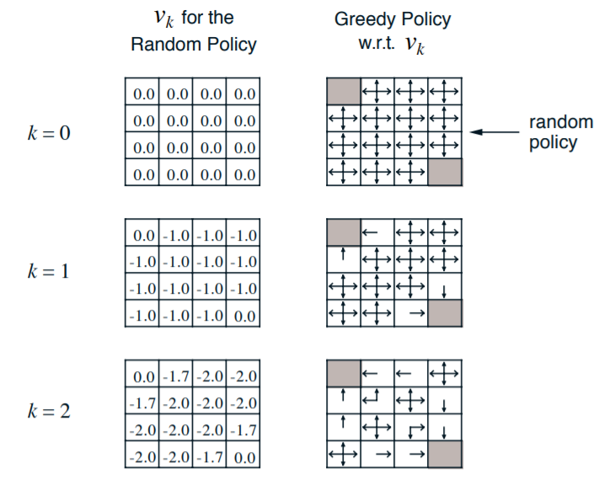
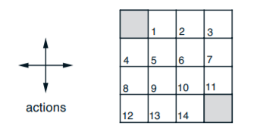
4 x 4 gridworld example
S = {1, 2, . . . , 14}
A = {up, down, right, left}
R = -1 for all transitions
Terminal state: Shaded cells
ℼ = all actions equally likely
Sutton, R. S., & Barto, A. G. (2018). Reinforcement learning: An introduction. MIT press.

Slide 22
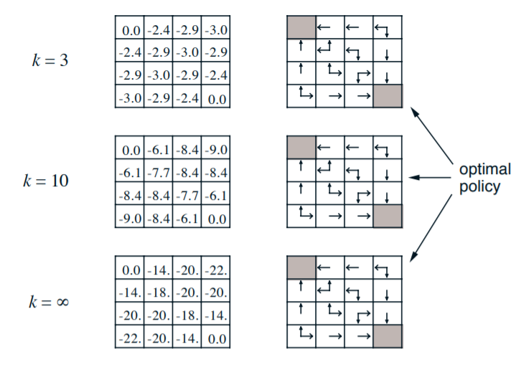
4 x 4 gridworld example
Sutton, R. S., & Barto, A. G. (2018). Reinforcement learning: An introduction. MIT press.

Slide 23
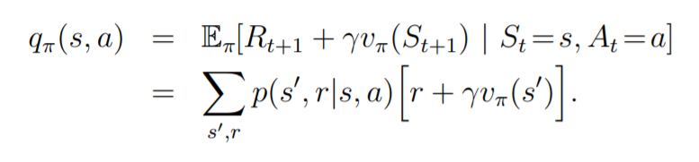
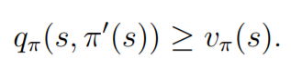
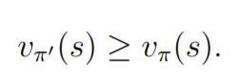
Policy Improvement
Reason for computing the value function for a policy is to help find better policies.
We know how good it is to follow the current policy from s — that is v_{ℼ}(s) — but would it be better or worse to change to the new policy?
Consider selecting a in s and thereafter following the existing policy, ℼ. The value of this way of behaving is:
If then
Sutton, R. S., & Barto, A. G. (2018). Reinforcement learning: An introduction. MIT press.

Slide 24
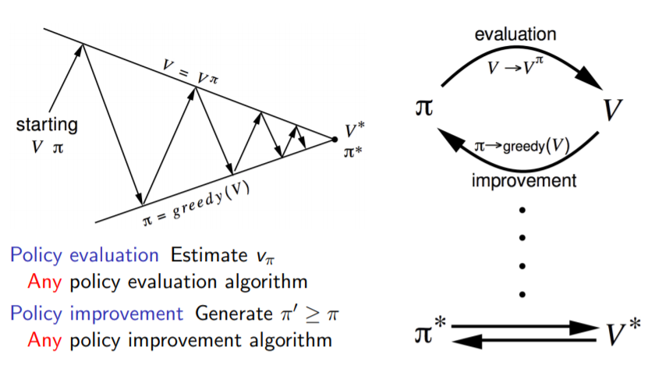
Policy Iteration
Once a policy, ℼ, has been improved using v_{ℼ} to yield a better policy, ℼ’ , we can then compute v_{ℼ’} and improve it again to yield an even better ℼ’’.
https://deepmind.com/learning-resources/-introduction-reinforcement-learning-david-silver

Slide 25
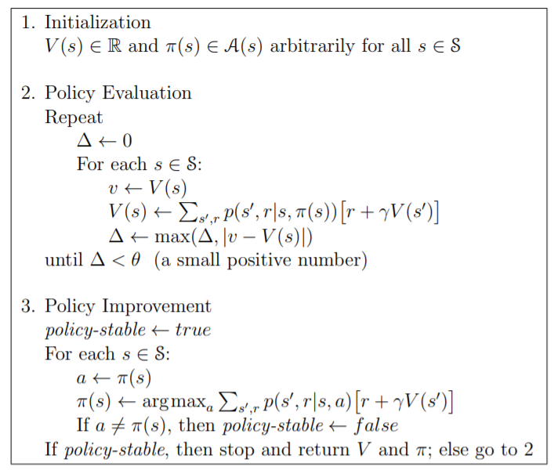
Policy Iteration
Sutton, R. S., & Barto, A. G. (2018). Reinforcement learning: An introduction. MIT press.

Slide 26
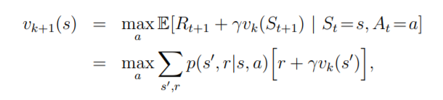
Value Iteration
One drawback to policy iteration is that each of its iterations involves policy evaluation, which does iterative computation requiring multiple sweeps through the state set.
Value Iteration: Update value with one step look ahead.
Sutton, R. S., & Barto, A. G. (2018). Reinforcement learning: An introduction. MIT press.

Slide 27
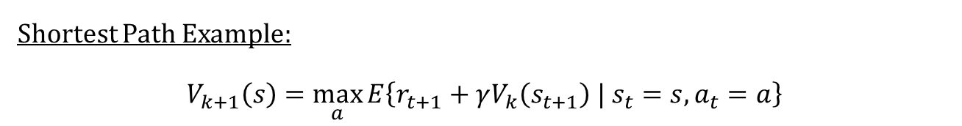
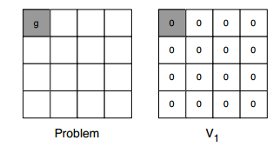
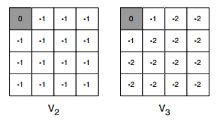
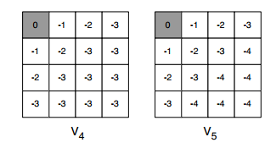
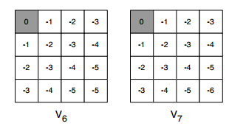
Value Iteration
Sutton, R. S., & Barto, A. G. (2018). Reinforcement learning: An introduction. MIT press.

Slide 28
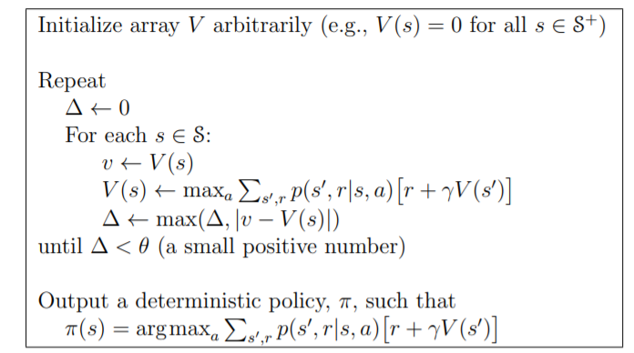
Value Iteration
What is the limitation of this Value Iteration?
Sutton, R. S., & Barto, A. G. (2018). Reinforcement learning: An introduction. MIT press.

Slide 29
Temporal Difference (TD) Learning
Can we learn from episodes of experiences without a model of the environment’s dynamics? Can we update estimates based in part on other learned estimates?
TD Learning:
Learn directly from episodes of experience
Model-free: no knowledge of MDP transitions / rewards
Learns from incomplete episodes, by bootstrapping
Updates a guess towards a guess
On-Policy TD Control - SARSA
Off-Policy TD Control - Q-learning
https://deepmind.com/learning-resources/-introduction-reinforcement-learning-david-silver

Slide 30
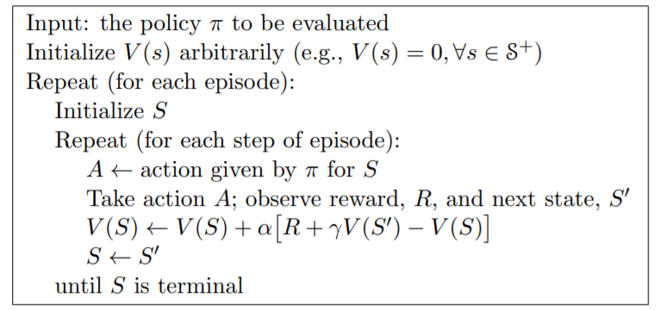

TD Prediction (TD[0])
TD Error = TD target - current estimate
Estimate Vℼ (s) given episodes generated under policy ℼ.
Backup diagram for TD[0]
Current estimate
Tabular TD(0) for estimating vℼ
TD target
Sutton, R. S., & Barto, A. G. (2018). Reinforcement learning: An introduction. MIT press.

Slide 31
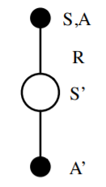
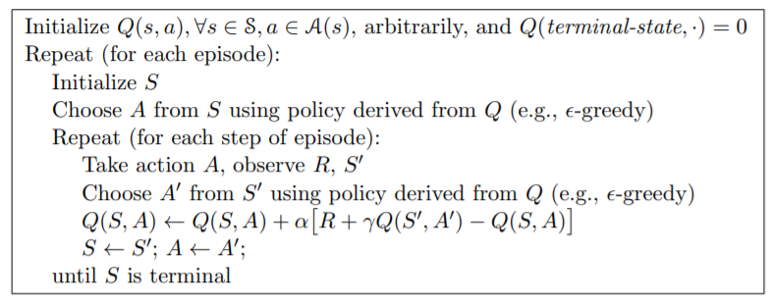
Sarsa (State-Action-Reward-State-Action)
Value function re-written as Q value function.
Sarsa update
Sutton, R. S., & Barto, A. G. (2018). Reinforcement learning: An introduction. MIT press.

Slide 32
Off Policy Learning
Evaluate target policy ℼ(a|s) to compute vℼ(s) or qℼ(s, a)
While following behaviour policy µ(a|s) {S₁, A₁, R₂, ..., S_{T} } ∼ µ
Why is this important?
Learn from observing humans or other agents
Re-use experience generated from old policies ℼ₁, ℼ₂, ..., ℼ_{t−1}
Learn about optimal policy while following exploratory policy
Learn about multiple policies while following one policy
https://deepmind.com/learning-resources/-introduction-reinforcement-learning-david-silver

Slide 33
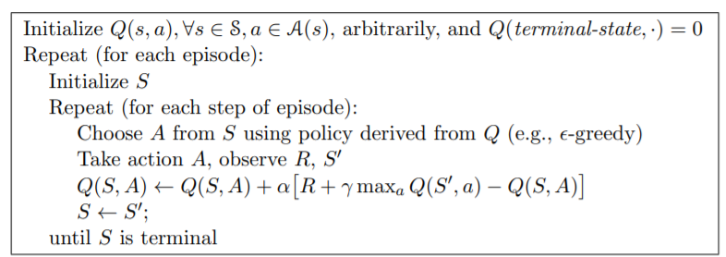
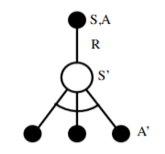
Q-Learning (Watkins, 1989)
Considered as one of the most important breakthroughs in reinforcement learning.
Q has been shown to converge with probability 1.
Q Learning update
Watkins, C. J. C. H. (1989). Learning from delayed rewards (Doctoral dissertation, University of Cambridge).

Slide 34
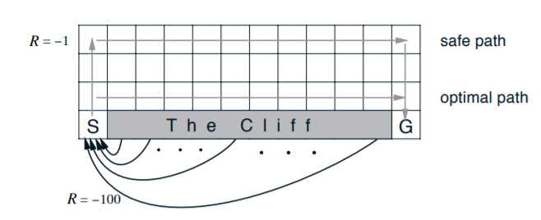
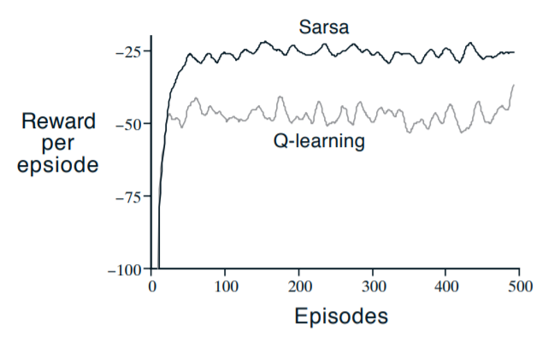
Sarsa vs Q-Learning
Q-learning learns values for the optimal policy.
Sarsa learns safer path.
Watkins, C. J. C. H. (1989). Learning from delayed rewards (Doctoral dissertation, University of Cambridge).

Slide 35
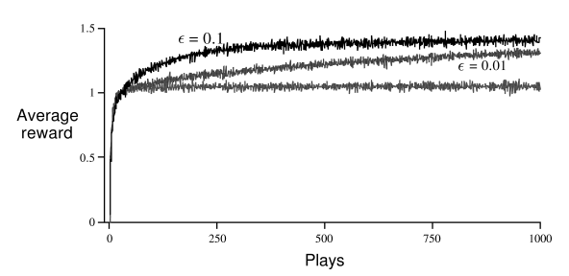
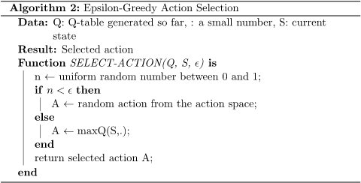
Exploration and Exploitation
Exploration finds more information about the environment.
Exploitation exploits known information to maximize rewards.
Sutton, R. S., & Barto, A. G. (2018). Reinforcement learning: An introduction. MIT press.

Slide 36
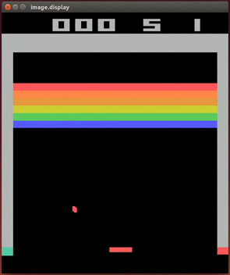
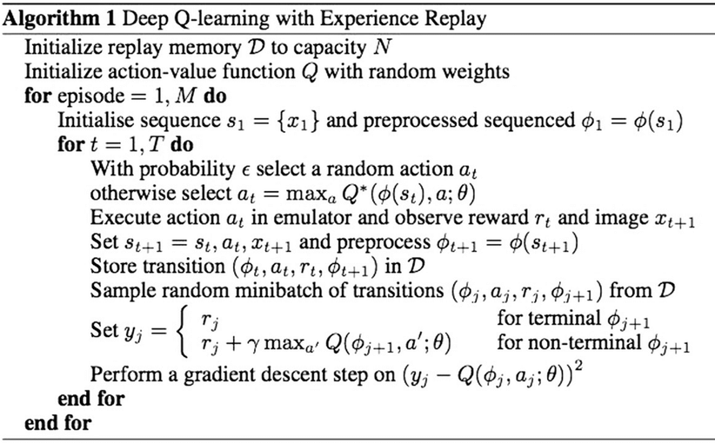
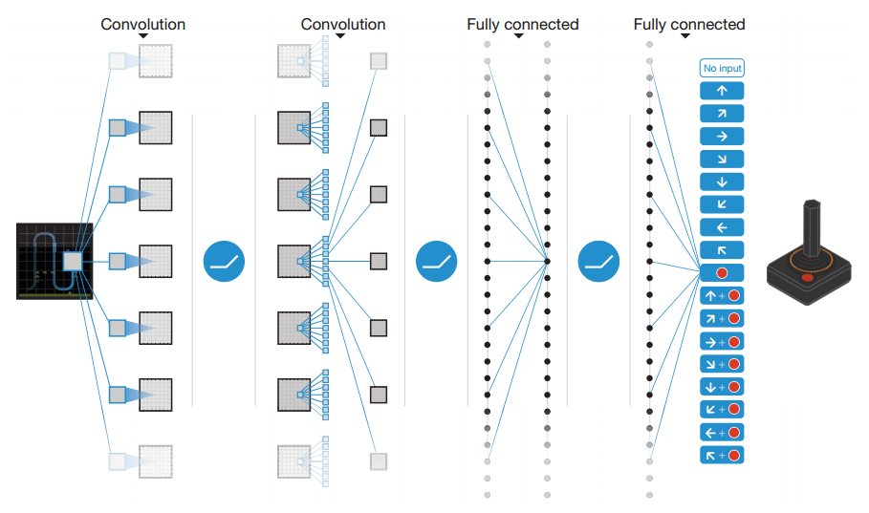
Deep Q-network (Google - Deepmind)
Mnih, V., Kavukcuoglu, K., Silver, D., Rusu, A. A., Veness, J., Bellemare, M. G., ... & Hassabis, D. (2015). Human-level control through deep reinforcement learning. Nature, 518(7540), 529-533.

Slide 37
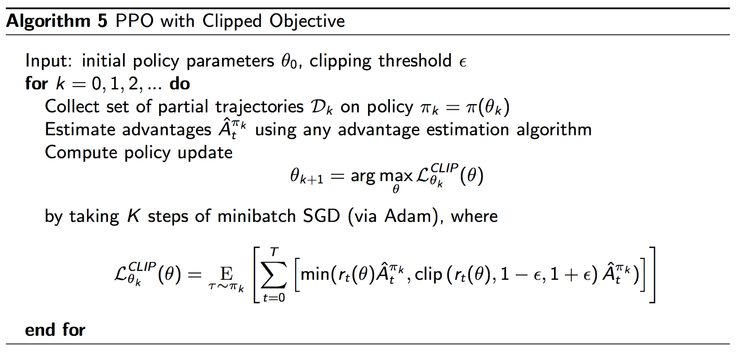
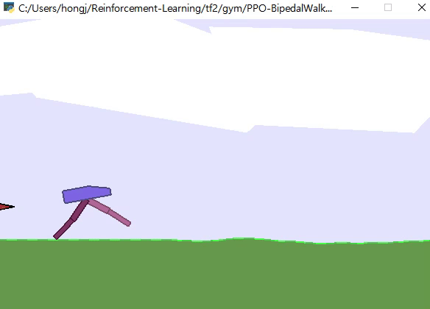
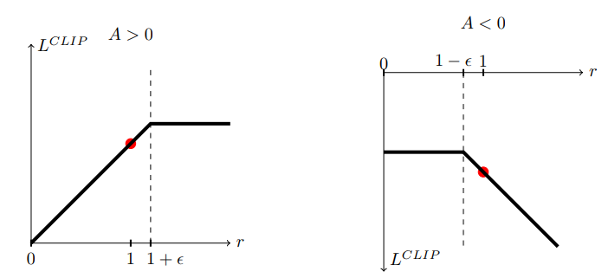
Proximal Policy Optimization (PPO)
For continuous control tasks.
https://github.com/hongjun7/Reinforcement-Learning
Advantage function:
A(s, a) = Q(s, a) - V(s)
Schulman, John, et al. "Proximal policy optimization algorithms." arXiv preprint arXiv:1707.06347 (2017).

Slide 38
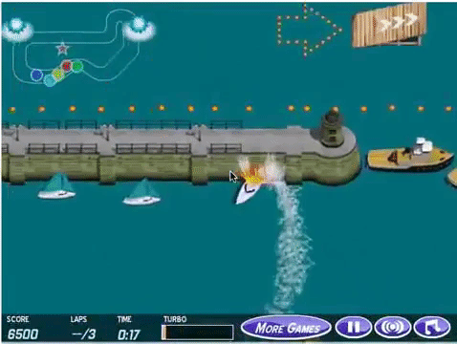
Challenges
Training off-line from the fixed logs of an external behavior policy.
Learning on the real system from limited samples.
High-dimensional continuous state and action spaces.
Safety constraints that should never or at least rarely be violated.
Tasks that may be partially observable, alternatively viewed as non-stationary or stochastic.
Reward functions that are unspecified, multi-objective, or risk-sensitive.
System operators who desire explainable policies and actions.
Inference that must happen in real-time at the control frequency of the system.
Large and/or unknown delays in the system actuators, sensors, or rewards.
Dulac-Arnold, G., Mankowitz, D., & Hester, T. (2019). Challenges of real-world reinforcement learning. arXiv preprint arXiv:1904.12901.
https://openai.com/blog/faulty-reward-functions/

Slide 39
References
Sutton, R. S., & Barto, A. G. (2018). Reinforcement learning: An introduction. MIT press.
https://web.stanford.edu/class/cs234/
https://deepmind.com/learning-resources/-introduction-reinforcement-learning-david-silver
Watkins, C. J. C. H. (1989). Learning from delayed rewards (Doctoral dissertation, University of Cambridge).
Mnih, V., Kavukcuoglu, K., Silver, D., Rusu, A. A., Veness, J., Bellemare, M. G., ... & Hassabis, D. (2015). Human-level control through deep reinforcement learning. Nature, 518(7540), 529-533.
Schulman, John, et al. "Proximal policy optimization algorithms." arXiv preprint arXiv:1707.06347 (2017).

